Slide 1
Project Title: Wave-Based Computation Using Dynamic Liquid Media and Quantum Simulation
Team Name: Quantum Minds
Mentor: Dr. S. Mohamed Nizar(AP)ECE
Institution: Rajalakshmi Institute Of Technology(RIT)
Team Members:
Akash S
Harish Ganapathy S
Ramya S

Slide 2
Weekly Progress Report (Week 8)
Progress Achieved This Week
Raspberry Pi 5 Setup
Raspberry Pi 5 was prepared for the project.
Raspberry Pi OS was successfully installed.
The operating system was booted and tested successfully.
The Raspberry Pi is now ready for sensor interfacing.
The software environment will be configured for Python, LiDAR data acquisition and Qiskit-based processing.
Raspberry Pi 5 is ready for the next stage of hardware integration.

Slide 3
Current Hardware Status
Raspberry Pi 5 – OS Installed & Ready
VL53L5CX LiDAR – To be obtained
Speaker – To be obtained

Slide 4
Next Hardware Integration
Once the VL53L5CX is available:
Connect VL53L5CX to Raspberry Pi 5.
Enable and test I²C communication.
Read the 8×8 distance matrix.
Verify sensor measurements.
Store measurement data for further processing.

Slide 5
Software Preparation
Current software work:
Designed the data-flow architecture.
Prepared simulated LiDAR data for testing.
Developed the initial Qiskit processing workflow.

Slide 6
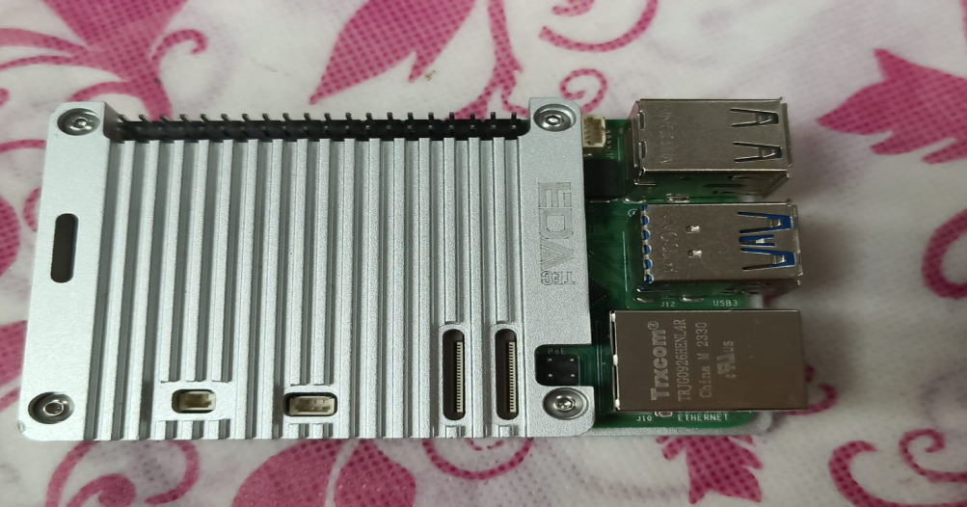
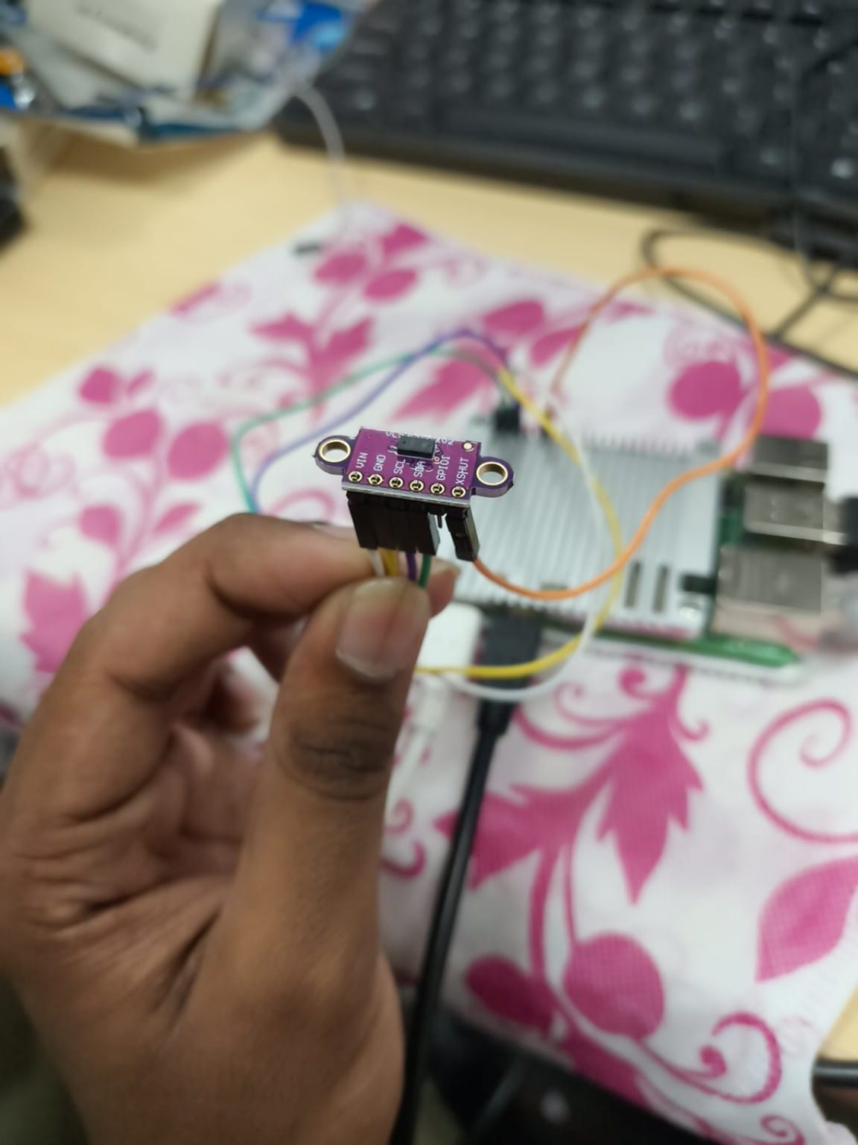
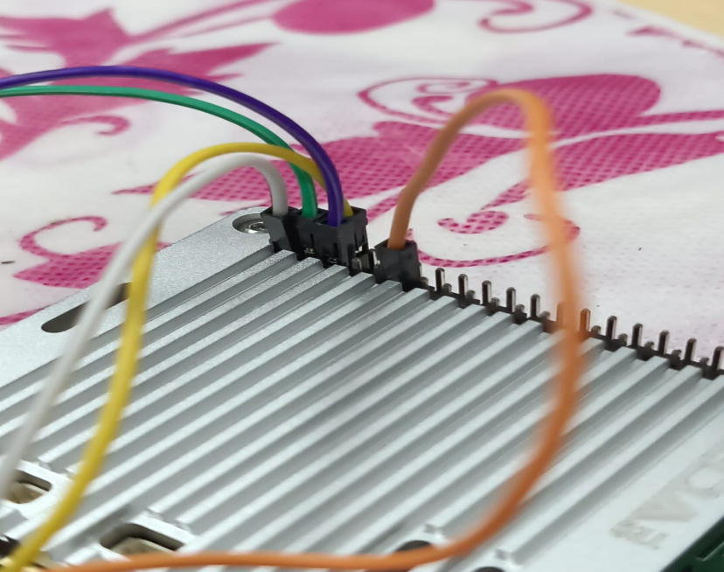
Hardware Setup

Slide 7
Next Week Plan
Hardware
Obtain the VL53L5CX sensor.
Obtain the speaker.
Interface the sensor with Raspberry Pi 5.
Test real-time 8×8 distance measurements.
Software
Collect real sensor data.
Save consecutive frames.
Develop preprocessing and feature extraction.
Integrate real sensor data with the existing Qiskit workflow.
Prototype
Start the liquid-wave setup.
Test sound-generated waves.
Observe the sensor response to wave patterns.

Slide 8


